Slide 1
Multiplying Decimals
WALT:
WILF:
Use mental and written methods to multiply numbers with decimals
Level 5
Is the answer to:
Is the answer to:
Is the answer to:
Using a mental method work out:
2.4 x 6
Calculate 321 x 25
Show your working out
Calculate 43.5 x 5.4
Show your working out
Level 5
Level 5
Level 6
Equivalent whole number calculation Estimate
Partitioning Using factors
Keywords

Slide 2











Multiplying Decimals
Starter:
10 questions to work out in your head. Write the question and answer:
1) 3 x 5 = |  | 2) 9 x 1 =
3) 6 x 4 = |  | 4) 10 x 3 =
5) 2 x 9 = |  | 6) 8 x 6 =
7) 6 x 7 = |  | 8) 7 x 7 =
9) 6 x 9 = |  | 10) 8 x 7 =
15
9
24
30
18
48
42
49
54
56

Slide 3
Multiplying Decimals
Example of Mental Multiplication:
Calculate: 0.03 x 0.05
3 x 5 = 15
0.03 x 0.05 = 0.0015
Four decimal places in the question, therefore four decimal places in the answer
Calculate: 900 x 0.004
900 x 0.004 = 90 x 0.04 = 9 x 0.4
= 3.6

Slide 4


Exercise 1:
Answer the following questions using mental methods
1
0.8 x 0.3
2
0.06 x 0.5
3
0.07 x 0.09
4
1.2 x 0.4
0.24
0.03
0.0063
0.48
5
0.13 x 1.3
6
0.2 x 4.3
7
0.4 x 1.03
8
1.4 x 14
0.169
0.86
0.412
19.6
9
0.8 x 200
10
0.05 x 300
11
800 x 0.002
12
60 x 0.3
160
15
1.6
18
13
900 x 0.003
14
700 x 0.0003
15
30 x 0.007 x 30
2.7
0.21
6.3
A packet of crisps contains 1.2g of salt. Lucy eats 0.7 of the packet of crisps. How much salt does she eat?
0.84g
James starts to drink 0.5 litres of smoothes each day to become more healthy. How much does he drink in 300 days?
150 litres
If today is Monday we know that in 702 days time (that is in 100 weeks and 2 days time) it will be Wednesday. What day will it be in 15 days? 26 days? 234 days? In 2, 9, 16 and 23 days from now, it will be a Wednesday. What other numbers of days from now will be Wednesdays? Can you generalise what you have noticed?

Slide 5
Multiplying Decimals
Examples of using written methods:
Work out : 15.2 x 0.14
152 x 14
x
100
50
2
1000
500
10
1000
500
20
20
4
400
200
8
400
200
+ 8
15.2 x 0.14 = 2.128
2128

Slide 6


Exercise 2:
Answer the following questions using written methods.
1
13.6 x 1.5
2
12.2 x 0.12
3
12.1 x 0.17
4
2.17 x 2.1
20.40
1.464
2.057
4.557
5
0.29 x 32.1
6
0.38 x 2.55
7
4.57 x 22
8
4.88 x 0.56
9.309
0.9690
100.54
2.7328
John buys 15 boxes of chocolate bars for his party. Each box costs £3.50. What is the total cost of the chocolate?
£52.50
Sarah saves £6.90 a week for his new computer for 8 months (4 weeks in a year). How much money does she save?
£220.80
Here is a 3 x 3 multiplication square. The numbers 1-9 may be used once and only once in the grid. Can you work out the arrangement of the digits in the square so that the given products are correct?
3 |  |  | 15
 |  |  | 108
 |  |  | 224
144 | 8 | 315
1
5
6
2
9
8
4
7

Slide 7
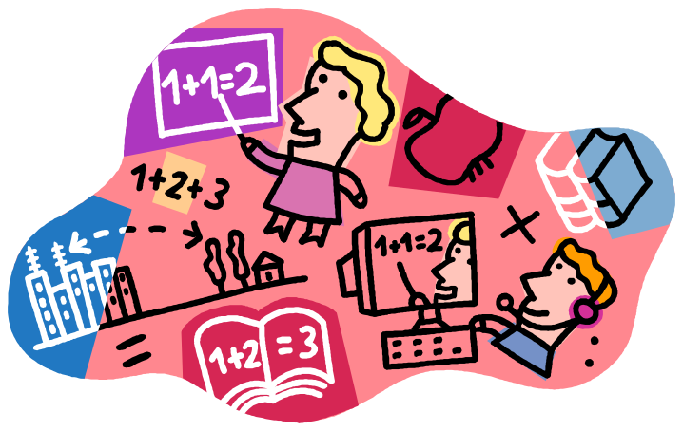
Multiplying Decimals
Summary:
Calculate the following questions.
1
0.04 x 0.5
2
0.04 x 700
3
5.82 x 4.5
4
0.68 x 0.42
0.020
28
26.19
0.2856

Slide 8
Multiplying Decimals
WALT:
WILF:
Use mental and written methods to multiply numbers with decimals
Level 5
Is the answer to:
Is the answer to:
Is the answer to:
Using a mental method work out:
2.4 x 6
Calculate 321 x 25
Show your working out
Calculate 43.5 x 5.4
Show your working out
Level 5
Level 5
Level 6
Equivalent whole number calculation Estimate
Partitioning Using factors
Keywords

Slide 9


Multiplication Homework:
Answer the following questions using mental methods
1
0.6 x 0.9
2
1.3 x 0.05
3
0.003 x 300
0.54
0.065
0.9
Answer the following questions using written methods. (SHOW WORKING OUT)
4
7.6 x 5.2
5
8.15 x 3.4
6
22.3 x 6.17
39.52
27.71
137.591
Petrol costs £1.04 per litre. Adam fills his car up with 20.4 litres of petrol at the petrol station. How much does it cost Adam to fill his car up?
£21.22
Here is a 3 x 3 multiplication square. The numbers 1-9 may be used once and only once in the grid. Can you work out the arrangement of the digits in the square so that the given products are correct?
 |  |  | 60
 | 9 |  | 189
 |  | 1 | 32
56 | 360 | 18
2
5
6
7
3
4
8

